Slide 1
Computer graphics III – Into
Jaroslav Křivánek
Charles University in Prague & Render Legion, a.s.

Slide 2
AGENDA

Slide 3
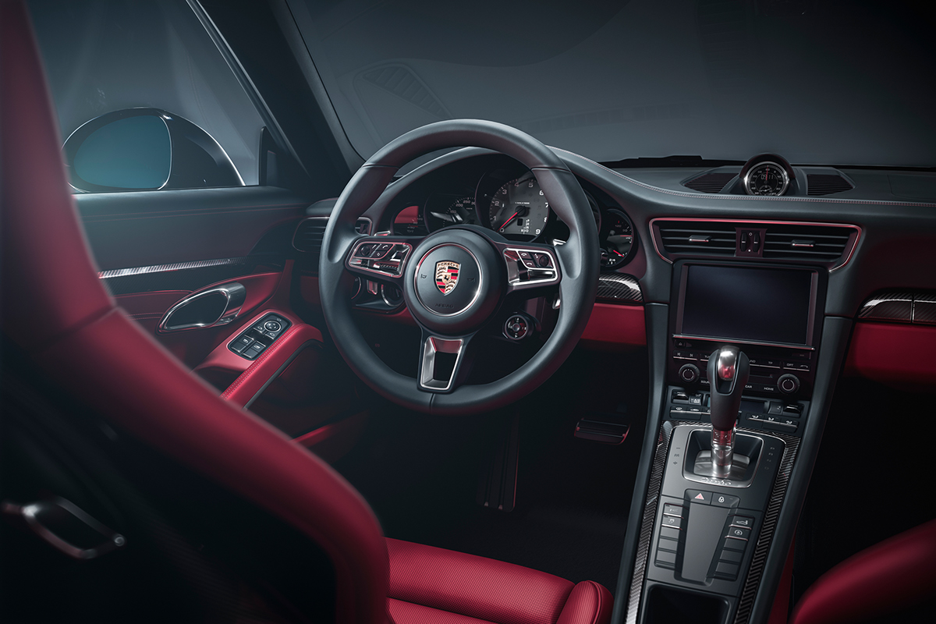
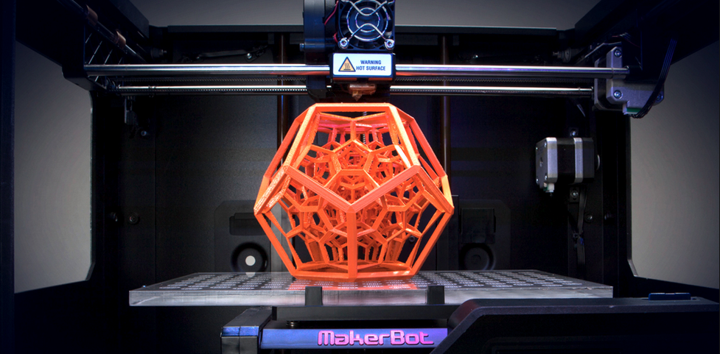
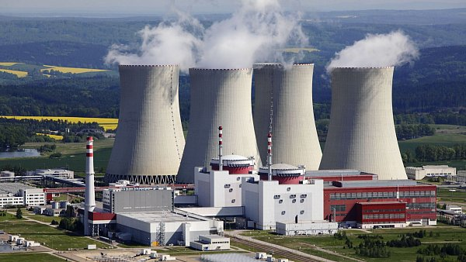
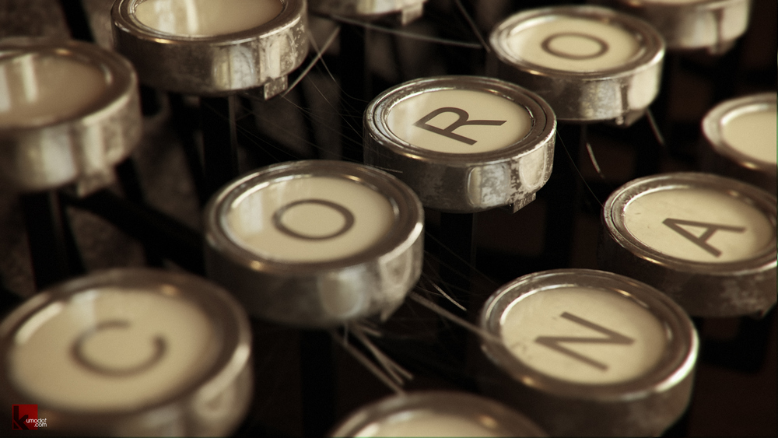

Rendering
3D printing & appearance fabrication
Nuclear reactor shielding

Slide 4
RENDERING

Slide 5
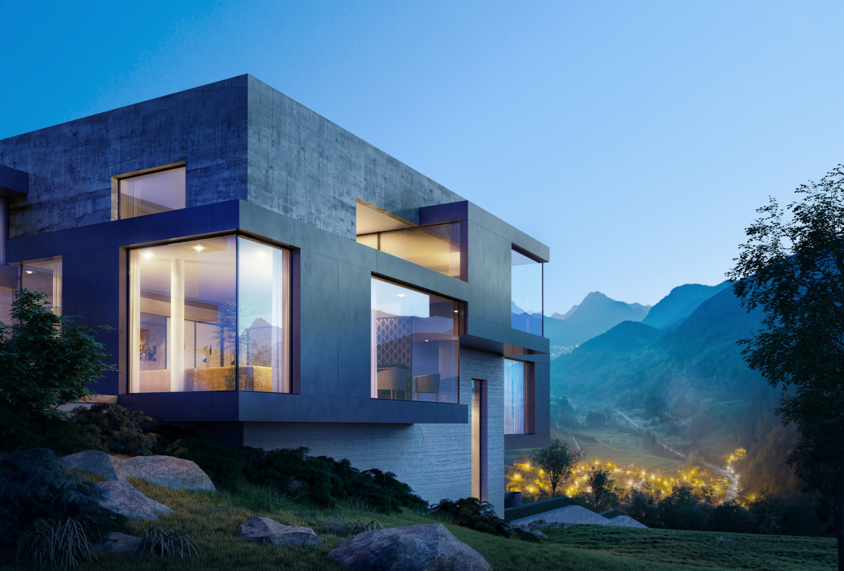

| Image by Divi Studio |
divistudio.com

Slide 6
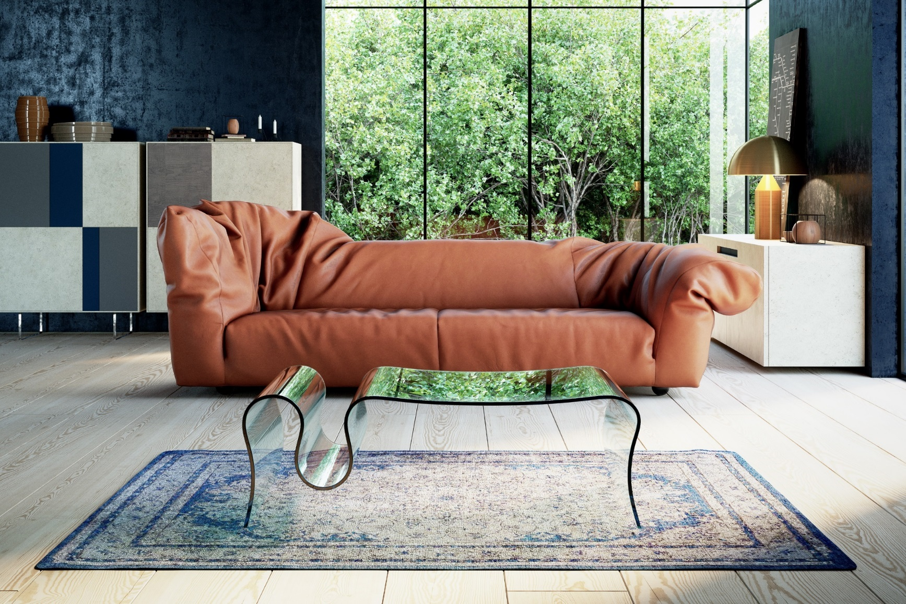
| Image by Jan Kudelasek |
allcity,cz

Slide 7
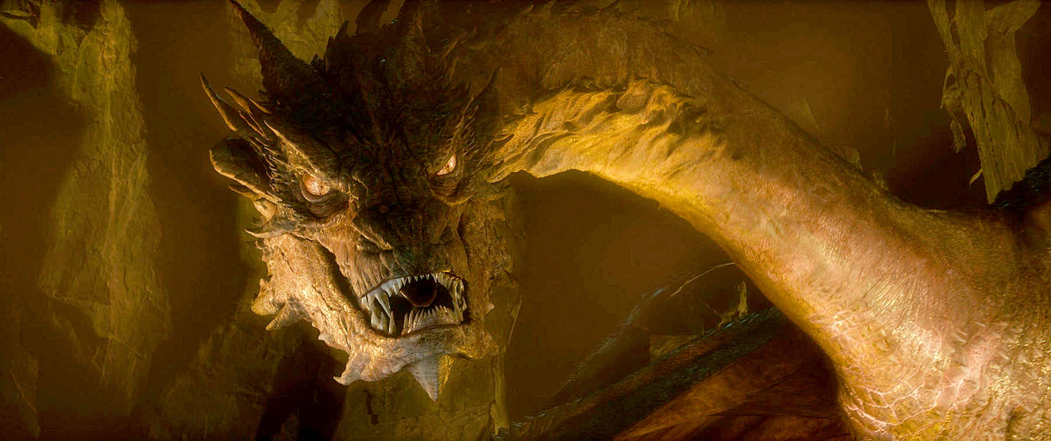
By Weta Digital
© 20th Century Fox

Slide 8
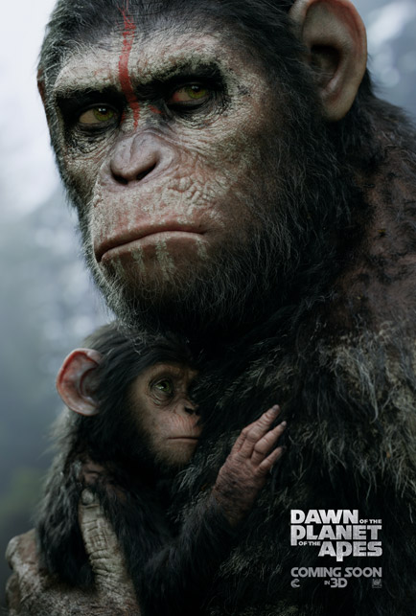
By Weta Digital
© 20th Century Fox

Slide 9
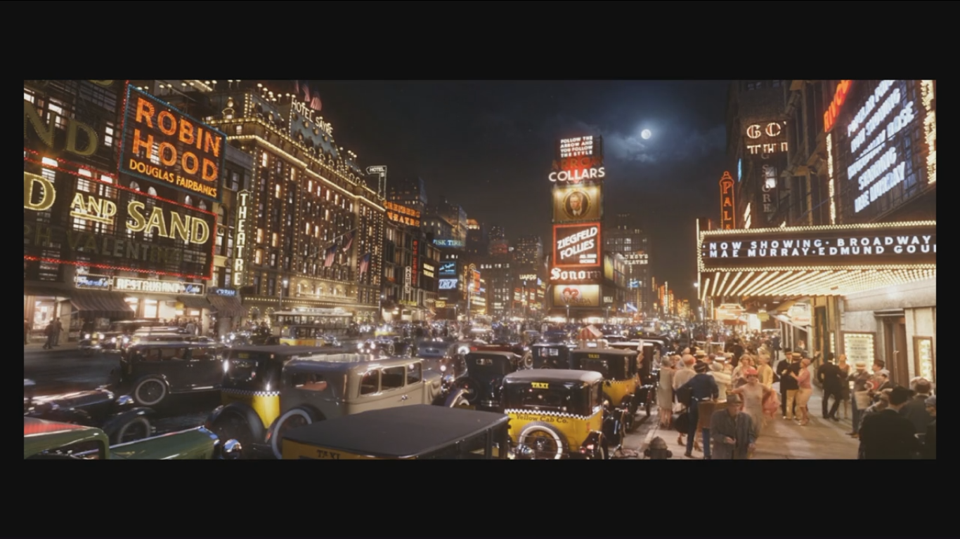

Slide 10
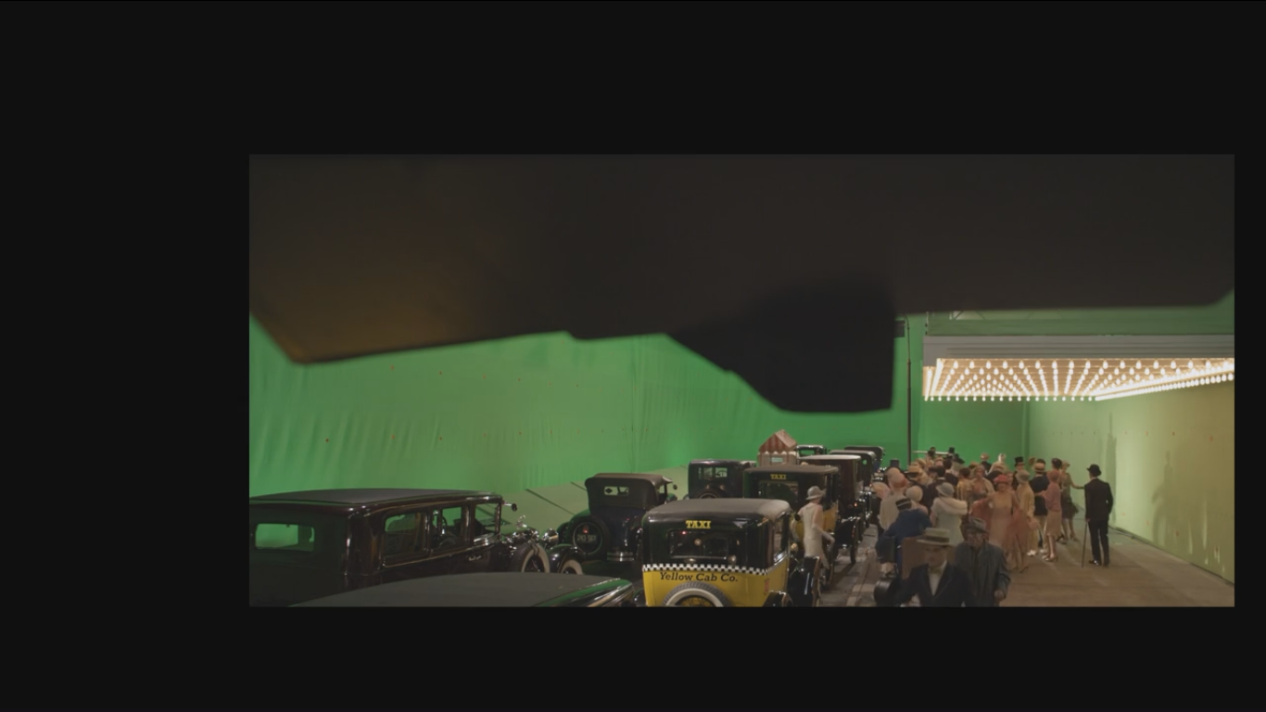

Slide 11
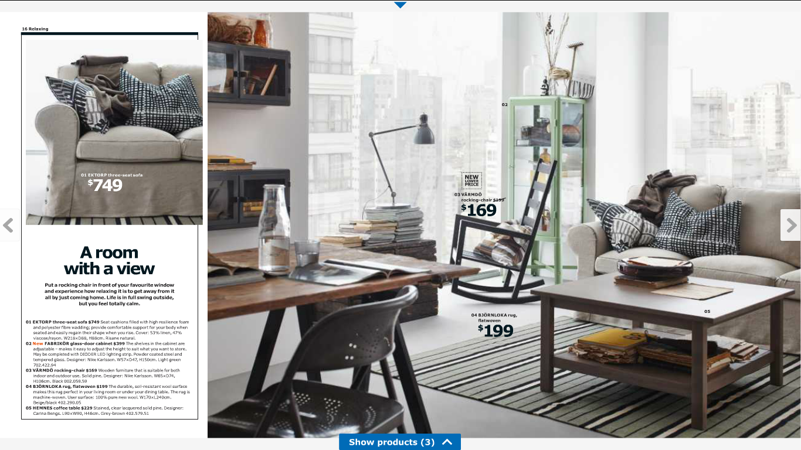

Notes:
… or furniture.

Slide 12
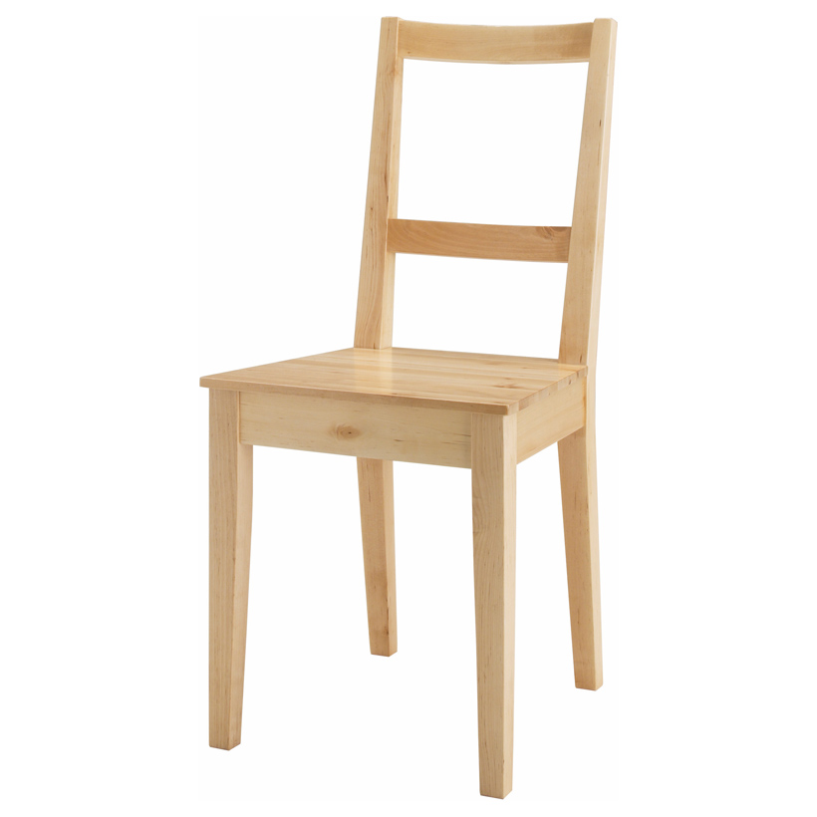
Chair “Bertil”, 2006

Slide 13
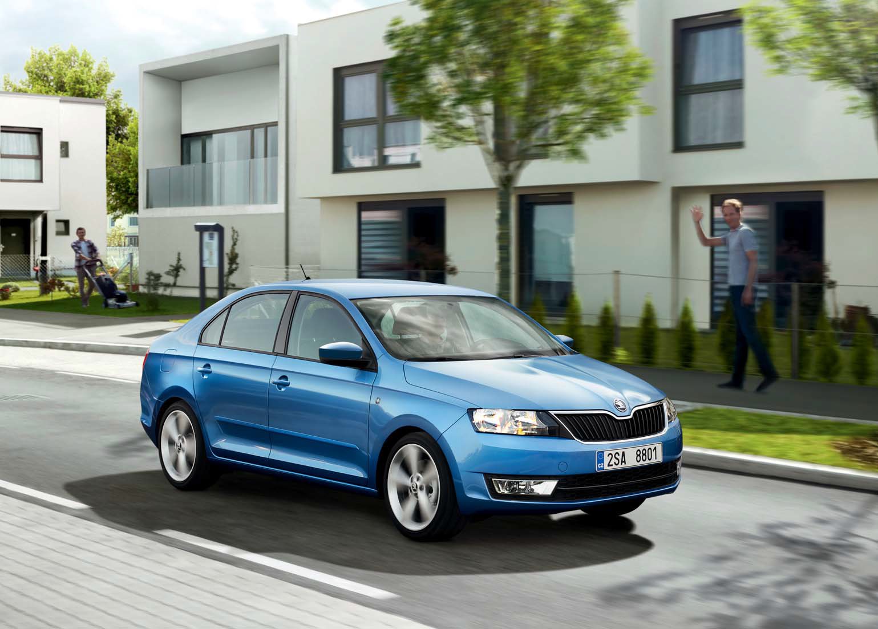
ŠKODA Catalogue
Notes:
The use of physically based rendering is really widespread.
Many product catalogues, such as for cars…

Slide 14




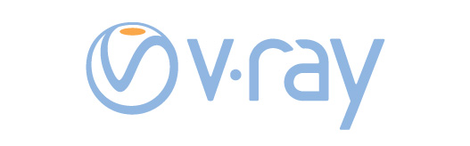

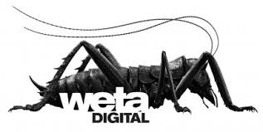


Notes:
By now, a wide range of existing commercial solutions based on ray tracing are available, with the pioneers still keeping their leading positions
V-ray continues to be the leader in archiviz
And Arnold is still the leader in VFX
Mental ray used to be strong but it’s become more of a legacy by now
As for archviz, numerous alternatives to V-ray are available, among which our Corona plays an important role.
In the VFX, PIXAR is trying to revamp their RenderMan
Some large production studios are building their own rendering solution
Weta digital (the makers of The Lord of the Rings or Avatar) have their Manuka renderer.
Don’t ask me why they decided to call it that way
But it’s not that hard to guess why the rendering developers of Disney Animation studios decided to call their baby Hyperion

Slide 15

Light simulation

Slide 16
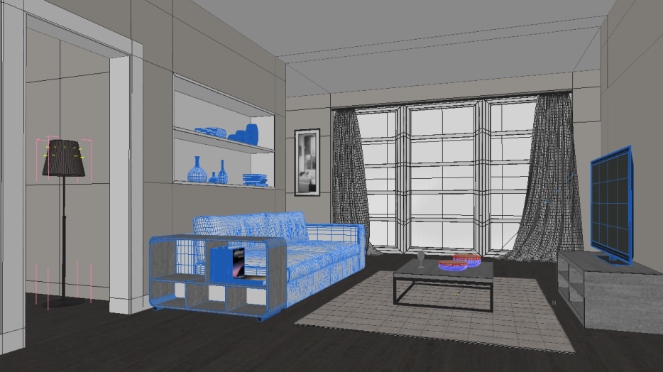
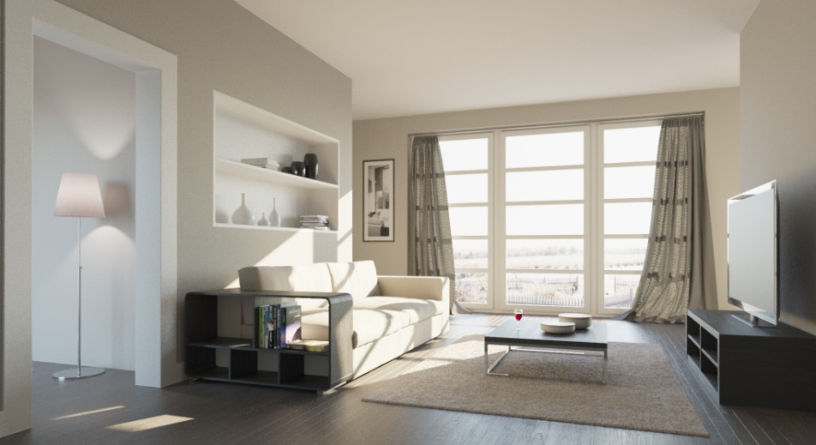
Rendering = (forward) light simulation
3D scene
Image
Notes:
But before I delve into the technical intricacies, let me start by stating what problem we are solving.
Give a scene …

Slide 17
3D PRINTING & APPEARANCE FABRICATION

Slide 18
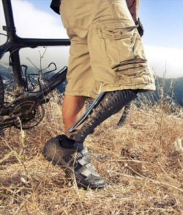
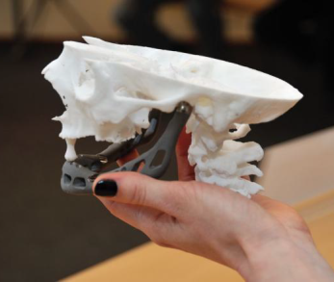
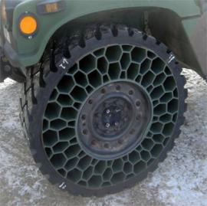
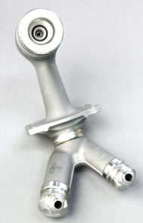
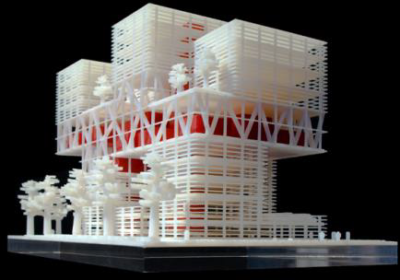
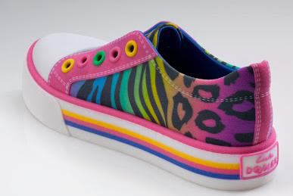
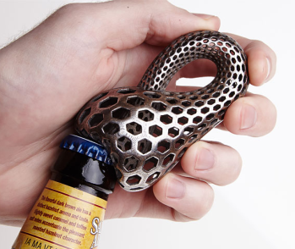
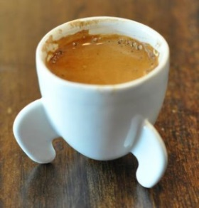
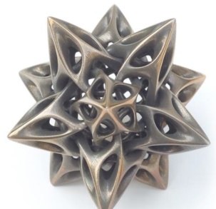
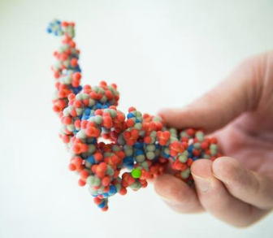
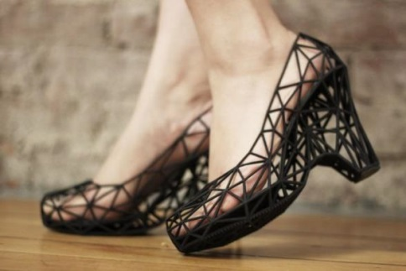
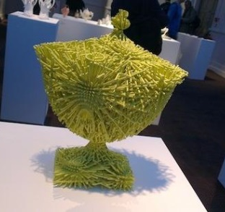
3D printing
prosthetics
auto & aero
prototyping
utility items
learning
fashion & art

Slide 19
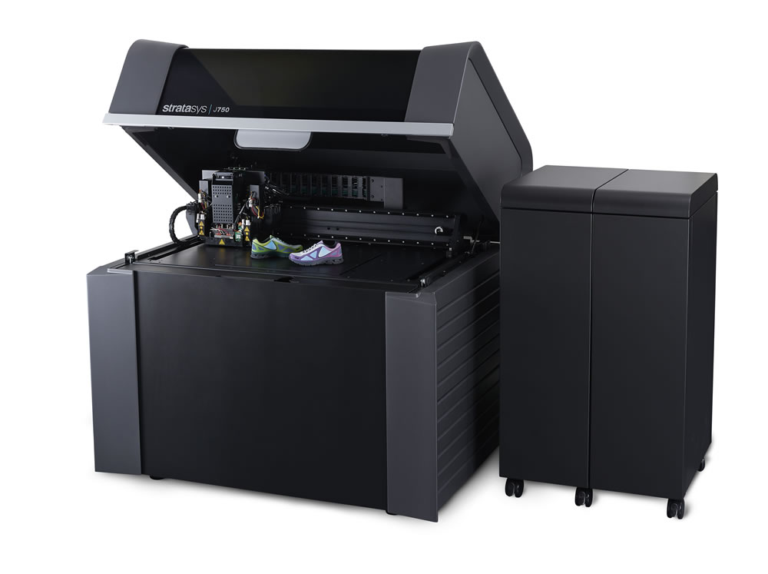
Multi-colored 3D prints
Stratasys J750 full color

Slide 20
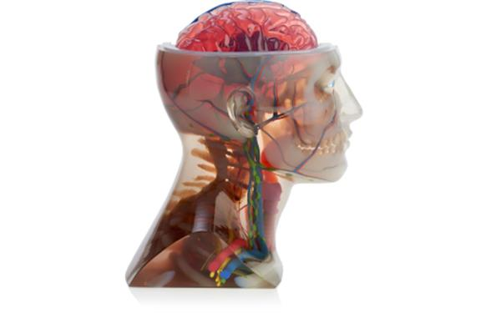

Slide 21
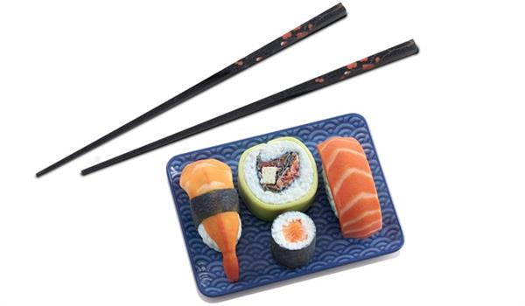

Slide 22
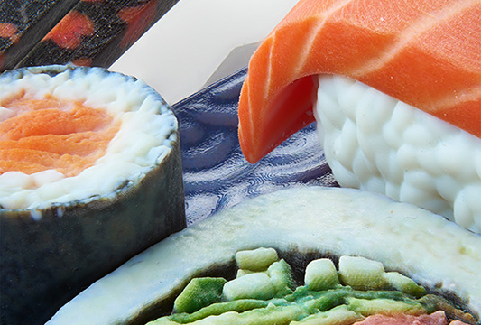
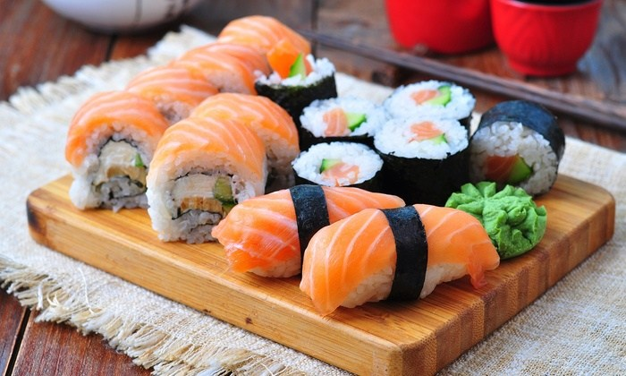
Does the 3D printed sushi look like real sushi?

Slide 23
New problem: “Realistic appearance fabrication”

Slide 24
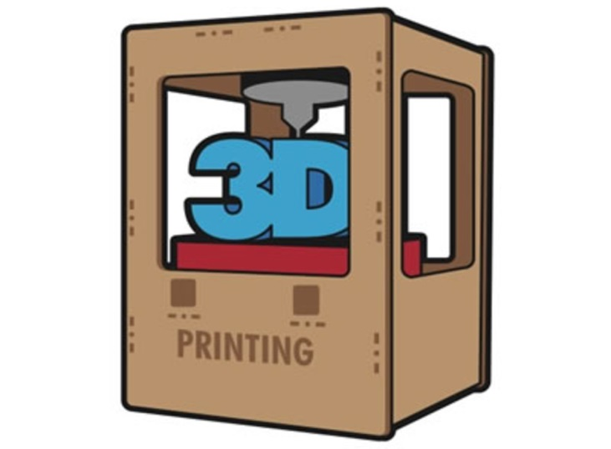
Appearance fabrication
?
Target
Some sort of
processing
Visual match

Slide 25
SCATTERING-AWARE TEXTRURE REPRODUCTION IN 3D PRINTING

Slide 26
Textured 3D prints

Slide 27
Translucency blurs textures
Target
Default print

Slide 28
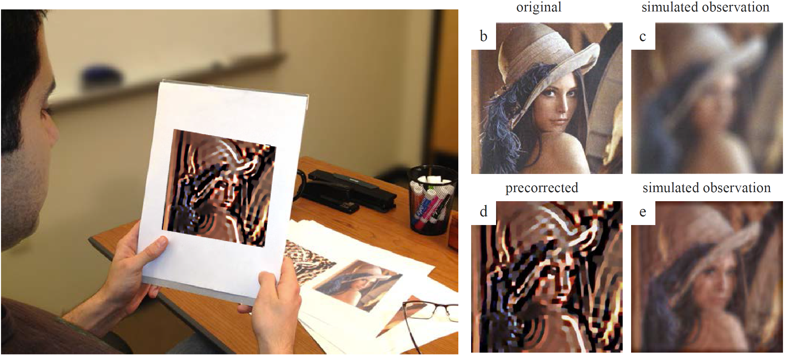
Precorrection for optical aberrations

Slide 29
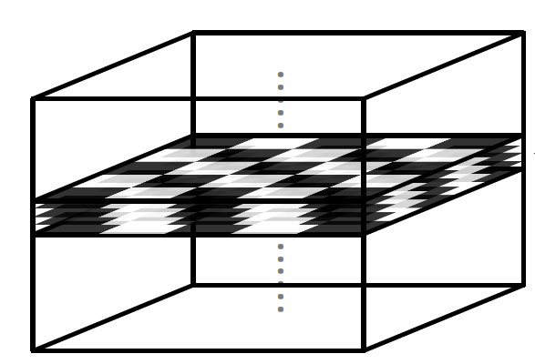
3D print is not just a flat image

Slide 30
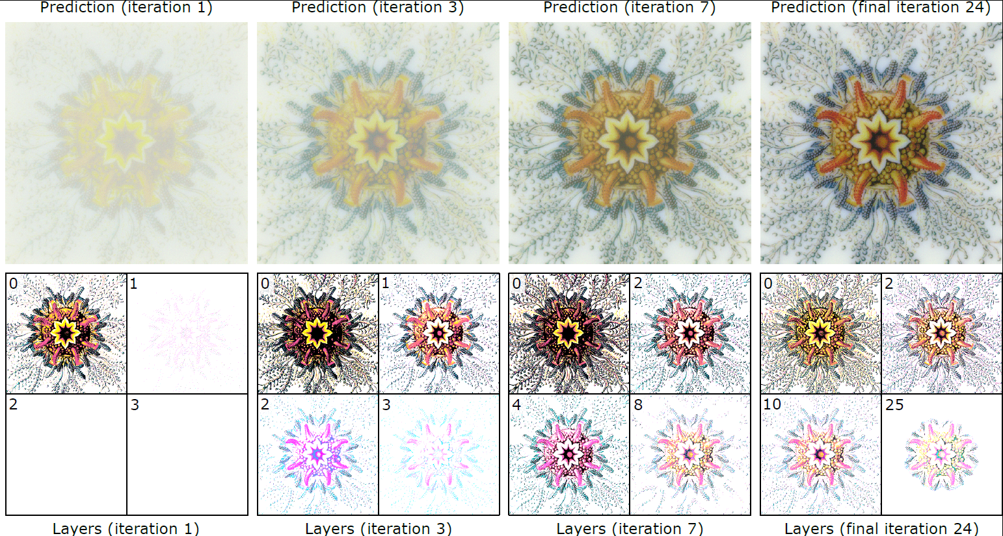
Iterative precorrection process
Target

Slide 31
Appearance fabrication
?
Target
Some sort of
processing
Visual match

Slide 32
Appearance fabrication
Target
Our
iterative
precorrection
Visual match

Slide 33
More results
Target
Default print
Our result

Slide 34
More results
Target
Default print
Our result

Slide 35
… BUT I WHAT ABOUT THE NUCLEAR REACTORS?

Slide 36
Light simulation – Unbiased Monte Carlo

Slide 37

Is it efficient? No, it’s not.
Up to hundreds of core hours

Slide 38
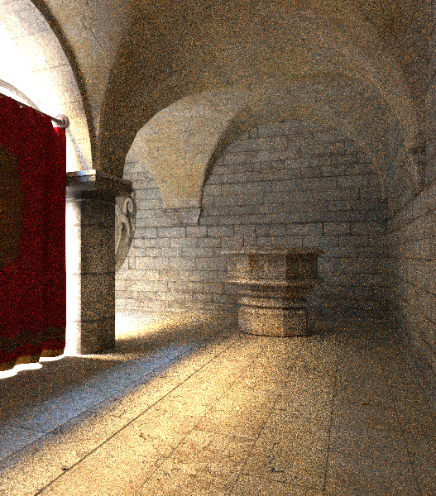
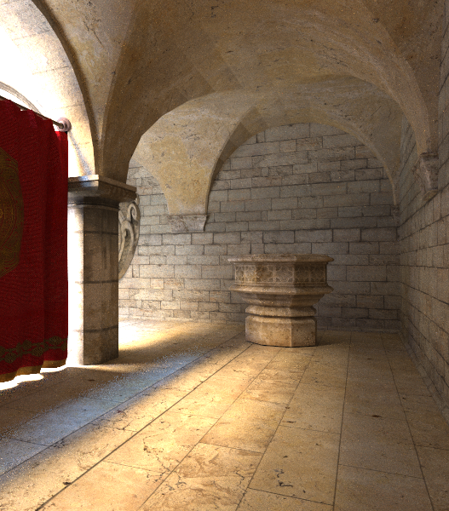
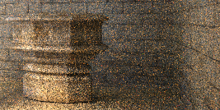
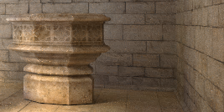
Variance → image noise
Vanilla path tracing
w/ variance reduction

Slide 39
Zero variance-based subsurface scattering
Křivánek and d’Eon. A Zero-Variance-Based Sampling Scheme for Monte Carlo Subsurface Scattering, ACM SIGGRAPH Talks 2014.

Slide 40
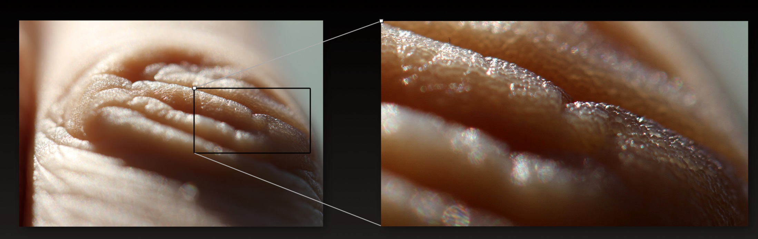

Slide 42
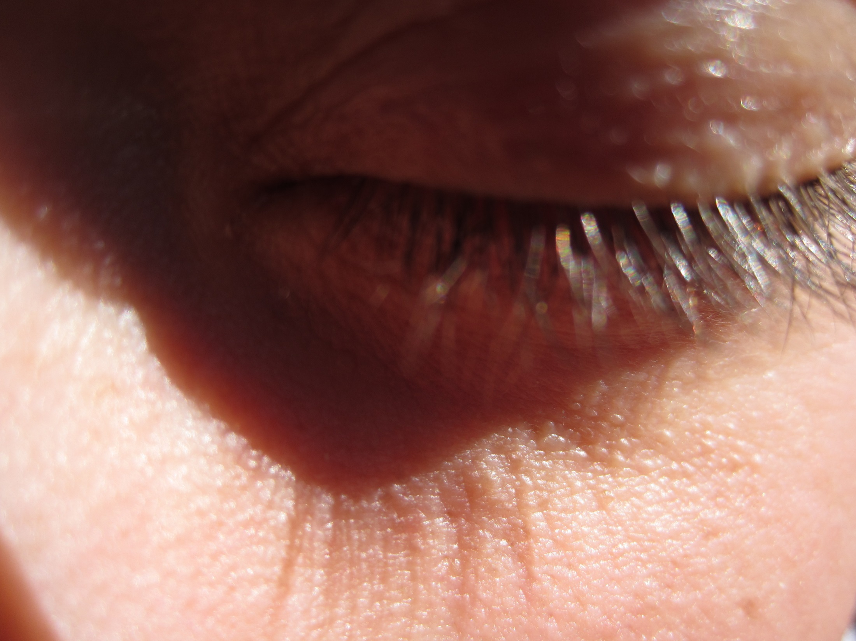

Slide 43
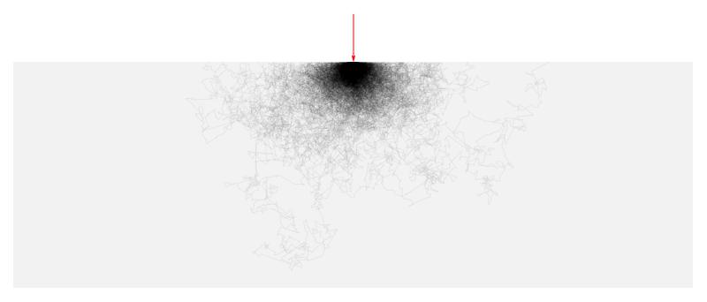
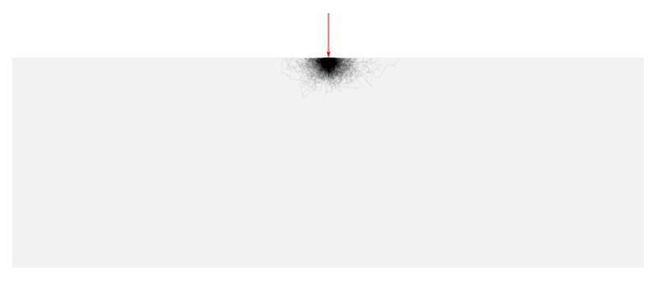
Light simulation under the surface
Classical random walk
  Oblivious to the boundary
Goal
  Guide paths toward the
  boundary

Slide 44
Previous work in neutron transport
Reactor shield design
  One in a billion particles makes it through
transmitted
radiation
incident
radiation
slab
(reactor shield)
Notes:
The so called “deep penetration problems” used in reactor shield design are particularly closely related.
By design, only a tiny fraction of the incident radiation is allowed to pass through a reactor shield.
For example, in a blind MC simulation only one in a billion particles would make it through, which makes the classic MC simulation totally hopeless.

Slide 45
Previous work in neutron transport
Path stretching [Clark ’66, Ponti ‘71, Spanier ‘71]
transmitted
radiation
incident
radiation
long step
short step
Notes:
One of the approaches to solve this issue is the so-called “path stretching”.
The idea is to advance the particles toward the outside by artificially stretching the sampled distance whenever the particle in a MC simulation points toward the exterior, and to shrink it when the particle is directed to the interior. To compensate for this, one needs to adjust the weight of the particle, because its behavior no longer follows the laws of physics.
Path stretching has originally been derived heuristically and relied on an ad-hoc parameter (the ‘strength’ of the stretching). While it often worked great, it could actually deteriorate the result (increase variance) when the stretching parameter wasn’t set judiciously.

Slide 46
Zero-variance random walk theory
Zero variance random walk theory
[Kahn ‘54, Kalos and Whitlock ’08, Hoogenboom ’08, Booth ‘11]
[Dwivedi ‘81]
  Synergistic path stretching and angular sampling
  Solid theory, no heuristics
Notes:
This is where the theory of zero-variance random walks comes into play.
The idea that a random walk can be constructed in such a way that it always yields the correct answer with absolutely no variance has been around for almost as long as MC methods themselves.
Despite the zero variance theory being old, Hoogenboom's recent 2008 NSE article (Zero-variance Monte Carlo Schemes Revisited) is very important: he corrects some misconceptions about the uniqueness of zero-variance walk construction that have lingered for several decades, and includes discussions about boundary crossing and track-length estimators as well.
Booth’s 2012 article (Common misconceptions in Monte Carlo particle transport) further clarifies and generalizes some of the concepts of zero-variance schemes. He argues that Hoogenbooms’ conclusion concerning the uniqueness of the zero-variance construstions are not correct and that there are multiple ways in which a zero-variance walk can be constructed.
Dwivedi [1981] was the first to apply the theory of zero-variance random walks to deep penetration problems.
He has shown how the heuristic path stretching automatically follows from the theory, while giving a clear answer to the parameter setting.
He was also the first to show that to robustly reduce variance, the path stretching needs to be combined with an appropriate angular sampling.
While he conceived his work with reactor shield design problems in mind, we apply his ideas to subsurface light transport and make further improvements.

Slide 47
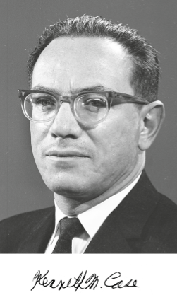
Analytical radiance solution
Case’s singular eigenfunctions
[Case 1960, McCormick and Kuscer 1973]
Singular eigenfunctions
transient terms
asymptotic terms
Notes:
In order to be able to build upon the zero-variance theory in constructing the random walk, we need an approximation of the radiance solution under the surface.
Note that the Monte Carlo estimator that we construct is unbiased irrespective of the accuracy of this approximate solution; the accuracy only affects the variance reduction but not the unbiasedness of the resulting estimator.
For this reason, we choose to approximate the true sub-surface distribution of radiance using a solution for a half-space with flat boundary.
In this setting, the phase space position r can be specified by the (optical) depth under the surface, x, and the direction cosine υ.
The exact half-space solutions that we use can be derived in several ways, including what is known as Caseology, named after Kenneth Case who was on the theoretical division at Los Alamos building the first bombs. In 1960 Case studied in detail the 'spectrum' of the transport operator in the plane-parallel case, and derived an expansion into the discrete asymptotic diffusion mode, and the continuous spectrum of 'singular eigenfunctions' - so named because the angular distributions (the phi-functions on the slide) for the transient terms are singular. This study of the structure of exact solutions in transport is incredibly insightful and we are the first, to our knowledge, to exploit it directly in a rendering technique.
Each eigenfunction of the spectrum has the same form: the spatial term that only depends on the depth under the surface is a simple exponential, with different eigenfunctions having different decay rates. The angular term then corresponds to integrating the spatial term along a line from a given depth in a given direction.

Slide 48
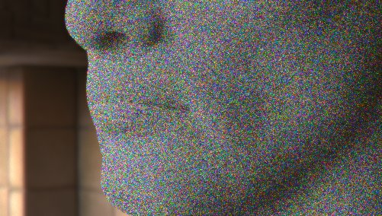

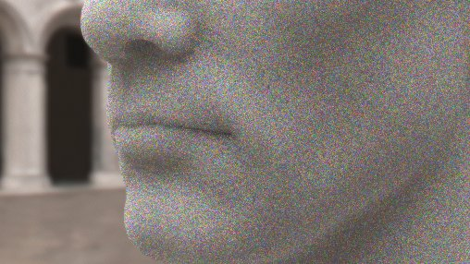
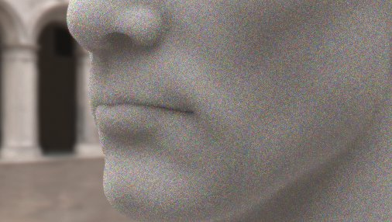
Use in rendering
MIS: 75% Dwivedi sampling + 25% “analog” sampling
equal-time comparison, 100 samples per pixel
classical sampling
our result
classical sampling
our result
Notes:
Despite the fact that the importance function driving the sampling assumes uniform hemispherical illumination, the modified path sampling lowers variance even when the illumination is nonuniform.
The images rendered with classical sampling use 100 samples/pixel while in our results we trace about 50% more samples/pixel in the same time.
While the speedup is a profitable side-effect, most of the variance reduction is due to the sampling pdfs closely approximating the zero-variance sampling scheme.
As on the previous slide, the subsurface medium has a single scattering albedo of 0.943 for all wavelengths and index-matched smooth boundaries.
The individual rows show results for different environment maps.

Slide 49



Slide 50
Conclusion

Slide 51
Conclusion
Appearance fabrication is a new interesting challenge
  Involves inverse rendering
Our light simulations can be smarter & more efficient
  Neutron transport and general transport theory can provide ideas

Slide 52


Slide 53

CGG BBQ

Slide 54



Slide 55


Slide 56


Slide 57



Vertex Connection & Merging (VCM)
SIGGRAPH Asia 2012
VCM (new)
BPT
PPM

Slide 58

Robust rendering of volumetric media
SIGGRAPH 2014

Slide 59

Notes:
Spolupracijeme I se studiem Pixar.

Slide 60



Slide 61





Slide 62


Slide 63


Slide 64



Slide 65
Image synthesis – A gentle intro

Slide 66
Rendering = (forward) light simulation
3D scene
Image
Notes:
But before I delve into the technical intricacies, let me start by stating what problem we are solving.
Give a scene …

Slide 67


Global illumination – GI
Direct illumination
Global =
direct +
indirect
67

Slide 68


Globální osvětlení
Direct illumination
  Light reflects only once on its way from the source to the camera
Global illumination
  Global = Direct + Indirect
  Light transport between surfaces in the scene
  Multiple reflections/refractions
Images © PDI/Dreamworks

Slide 69

Global illumination effects
Ideal (mirror) reflection / refraction
Color bleeding
Caustics

Slide 70

Ideal (mirror) reflection/refraction
Glass, mirror, water surface
E.g. the image we see on a water surface is due to light in a completely different part of the scene (bottom, environment, sky, sun)

Slide 71


Color bleeding
Light reflected from one diffuse surface onto another
Important for understanding of the spatial relationships of objects in a given scene (this happens subconsciously)

Slide 72

Color bleeding
Image courtesy Michael Bunnell
72

Slide 73

“Manual” global illumination
Monsters Inc., 2001
© Pixar Animation Studios
Manually placed light sources as a proxy for GI
  E.g. The cyan-ish tint on Mike Wasowski “reflected” from Sulley’s belly
Was used before full GI simulation started to be feasible

Slide 74


Caustics
Focusing of light as it’s reflected or refracted, leading to local increase of intensity
Photograph
Simulation using photon maps

Slide 75


Caustics
In physics or in computer vision, a caustic refers to a singularity of light intensity (infinite density of light energy)

Slide 76


What do we see when we look at a surface of a swimming pool?
Reflections + refractions on
water surface
Caustics at the bottom

Slide 77
Caustics under water surface
High „concentration“ of photons – high light intensity
Low intensity

Slide 78
Realistic image synthesis: Ingredients
Describe the “amount of light” in space – radiometry
Describe light interaction with surfaces – BRDF
Describe equilibrium light distribution – rendering equation (RE)
Image rendering = numerical solution of the RE
  Find the light distribution in a given scene that fulfils
    The rendering equation
    The „boundary conditions “ = i.e. the scene model
  Methods
    Finite elements (radiosity) – obsolete
    Monte Carlo (stochastic ray tracing) – prevalent

Slide 79
Light

Slide 80
Realistic image synthesis
How much light?

Slide 81


Slide 82
Different approaches to rendering
Phenomenological
  Traditional, “old” computer graphics
  E.g. Phong shading model, colors between 0 and 1, etc.
Physically-based
  Based on a proper mathematical formulation
  Rendering algorithms = numerical methods for solving the rendering equation
  Radiance values between 0 and infinity

Slide 83
Mathematical model
Image synthesis (rendering) = light transport simulation
We need a mathematical model for light
Formulation of the model = choice of level of detail
  No need to model the behavior of every single photon
  Need simplifying assumptions

Slide 84

Light
EM radiation (an EM wave propagating through space)
Image: Wikipedia

Slide 85

Light
Frequency of oscillations => wavelength => perceived color
Image: Wikipedia

Slide 86
Various kinds of optics
Geometry (ray) optics
  Most useful for rendering
  Describes bulk, macroscopic effects of light
  It is not a complete theory (Does not describe all observed phenomena, such as diffraction, interference etc.)
Wave optics (light = E-M wave)
  Important when describing interaction of light with objects of size on par with the light wavelength
  Interference (soap bubbles), diffraction, dispersion
Quantum optics (light = photons)
  Necessary to describe interaction of light with atoms

Slide 87

Effects of the wave nature of light
Interference
  Causes iridescence (structural coloration)
Constructive
Destructive
Img: Wikipedia

Slide 88


Iridescence
Thin-film interference
Color changes with the observation angle
Img: http://en.wikipedia.org/wiki/Iridescence

Slide 89

Iridescence – Structural coloration
Biological tissues can have layers causing interferences
Img: http://en.wikipedia.org/wiki/Iridescence

Slide 90

Iridescence – Structural coloration
Img: http://en.wikipedia.org/wiki/Iridescence

Slide 91

Iridescence – Structural coloration
Img: http://en.wikipedia.org/wiki/Iridescence

Slide 92

Polarization
Preferential orientation of the E-M waves with respect to the direction of travel
Unpolarized light – many waves with different polarization
More in the “Predictive
rendering” class

Slide 93


Polarization
Skylight is partially polarized
Specular reflections are polarized

Slide 94

Notes:
So now you’ve had a look at what people can do with Corona. Let me tell you some quick facts about corona and our developers mantra.
And the reason why Ondrej started developing Corona. Corona was originally meant to be simple research project for his bachelor thesis, but it grown into something bigger over the years.
Me and Ondrej were taking a part in CG community in Czech republic and we both worked as visualisers, but felt, that the tools which were available at the time were not giving us the artistic freedom which we wanted. Everything was too technical. So that we as artist were forced to learn and understand the mechanics of the rendering and physics in order to produce images, something what should be easy. So we have decided that we could possibly evolve corona to commercial software at some point.

Slide 95
| Image by Jan Kudelasek |
allcity,cz

Slide 96

| Image by Talcik&Demovicova |
talcikdemovicova.com

Slide 97

| Image by Chebosiba |
Notes:
Back to interiors.

Slide 98

| Image by ExorbitArt |
exorbit-art.de

Slide 99
| Image by Divi Studio |
divistudio.com

Slide 100

| Image by Vovk Nazarii|
www.behance.net/Mirmidonets

Slide 101

| Image by AsymmetricA |
Asymmetrica.co.uk

Slide 102

| Image by Efflam |
Asymmetrica.co.uk
Notes:
You can also do highly stylised imagaes

Slide 103

| Image by AsymmetricA |
Asymmetrica.co.uk

Slide 104

| Image by Onur Dursun |
http://duronautomotive.daportfolio.com/

Slide 105


Slide 106

| Image by Jeonimo Gomez |
Notes:
We see more and more interesting work from Latin America and Eastern Europe. Mostly animations with characters, animals these days.

Slide 107

| Alexander Zhadanov|
Notes:
This is a shot from advert for Russian bank. You can render living animals as

Slide 108

| Image by Sergey Kolbasnikov|
Kolbasnikov.com
Notes:
As well as hyper-realistic images using same shaders.

Slide 109

| Image by Daniel Dulitzky|
Notes:
You can render highly stylised work with corona

Slide 110


Slide 111

Notes:
Before getting into Corona’s feature set, let’s sidestep a moment to our story.

Slide 112




Founders
Ondřej Karlík
Adam Hotový
Jaroslav Křivánek
Partner
development
Partner
business
Partner
research

Slide 113


Slide 114

Notes:
You can achive everything if you have a good plan – This was our improvised trello board.

Slide 115

Notes:
The contents of your fridge will changes.

Slide 116

Notes:
Ve vasi nove kancelari

Slide 117

Notes:
Nachazejici se na luxusni adrese

Slide 118

Notes:
And we also had a cake next day in our

Slide 119

Notes:
Ktery civilizovane snite plastikovymi nozi

Slide 120

23 Members
3 Countries
2 Offices
Notes:
But now we have grown to a team of 15 professionals spread across the Czech Republic, Poland and the USA. As you can see, we reinvest the money from Corona into its development, not into fancy clothes….

Slide 121


Slide 122


Slide 123


Slide 124
Thank you!
cgg.mff.cuni.cz/~jaroslav

